Slide 1

PHPUnit, Unit Testing
Ronald Unz, Kate Phillips, Sean Douglas
Notes:
Hello, I'm Sean Douglas, and together with Kate Phillips and Ronald Unz we are delivering a brief presentation of PHPUnit as a Unit Testing Tool.

Slide 2
Introduction
Broad Overview of Unit Testing
Importance of Unit Testing
Why Automated Support is Important
Tools available for different frameworks
Why PHPUnit was chosen
PHPUnit Background
Where to find PHPUnit
Overview of tool functionality
Notes:
During this presentation, we will discuss a broad overview of Unit Testing, tell you why it's important and why automated support is important. We will also list various unit testing tools available for different frameworks, discuss why we chose PHPUnit, and provide some background on PHPUnit, including where to find it and an overview of its functionality.

Slide 3
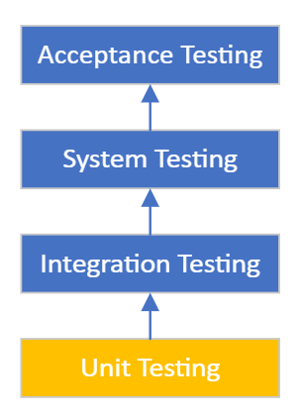
Introduction – Unit Testing
Unit testing is the testing of small, individual snippets of code or features
Software is broken down into individual “units” that are testable
Classes
Objects
Methods
Can be anything, but the smaller the better
Units can have no external dependencies
Units are tested by building individual test cases
Each unit can be tested as part of continuous integration
Notes:
To start, we should briefly discuss what exactly "Unit Testing" is. Unit testing is a commonly used method of testing. It simply involves the individual testing of small snippets of code or features that are broken down from a larger piece of software. These units might be classes, objects, methods, or any other sections of code, keeping in mind that whatever the unit is, the smaller the better. These units can have no external dependencies to prevent changes made to a unit from affecting other units. Units are tested by building individual test cases, and each unit can be tested as part of a continuous integration.

Slide 4
Importance of Unit Testing
Debugging is easier and faster
Reduces chances that new bugs will be created when fixing found bugs
Problems can be identified and found early in development
Reduced costs of detecting defective code
Code is modularly developed, so can be more usable
Leads to faster development and reduces bug occurrence
Better and simpler integrations
Reduced costs to modify software
Notes:
Unit testing methods are importnat because they provide many benefits to the software development process. Unit testing helps debugging go faster, and unit testing can be automated to further increase speed. The requirement that units have no external dependencies prevent bugs from propograting from unit-to-unit during the debugging process, so it reduces chances that new bugs will be created when fixing found bugs and prevent their recurrence. This kind of compartmentalization also allows developers to identify problems and fix them early in the development process, which leads to reduced chances of finding defective code and therefore, reduced costs of development. Moreover, units that test bug-free can be re-used... this kind of modularity and re-use leads to better and simpler integrations, which minimizes costs of future development and modification as well as debugging times. As useful as unit testing can be, it's important to remember that it won't fix every bug in a piece of software being developed, but it will help significantly.

Slide 5
Importance of Unit Testing
Builds confidence in development
Tests can be written before code, this can assist with ensuring new features meet requirements
Tests can be reused anytime something is changed in the project
Early testing can assist with documentation
Enables Test-Driven Development (TDD), which can help reduce bug density and produce better code
Notes:
All of this builds confidence in devleopment. Moreover, tests can be written before the code is developed, which can help with ensuring that new features meet requirements and specifications. Also, just like verified bug-free units, the tests can be re-used when something is changed in the product or project. Early testing also can help with the development of comprehensive documentation, and minimizing the amount of time spent building and correcting it. Finally, unit testing enables what we call Test-Driven Development, which can help reduce bug density and produce even better code. At this point I will turn our presentation over to Kate Phillips, who will continue with a discussion on why we would want automated support.

Slide 6
Why automated support?
Allows developers to “fail fast”
Consistent faith new features did not implement bugs
Ensures we are testing as much of the codebase as possible
Continuous integration of new features
Very helpful in a team development environment
Bottom Line: Cost-effective and time-efficient

Slide 7
Example tools available
Java framework – JUnit
PHP framework – PHPUnit
C++ frameworks – UnitTest++ and Google C++
.NET framework – NUnit
Python framework – py.test

Slide 8
Why choose PHPUnit?
PHP used for our development project
Most widely used tool for PHP development
Open source and freely available
Wide Range of Reporting Tools
Built into Travis CI
Supports mock objects with pre-defined behavior to test dependencies independently
Built-in assertions cover the vast majority of likely testing
Runs entire group of tests as a batch and provides a single report

Slide 9
PHPUnit Background
Sebastian Bergmann, original developer
Initial release Nov. 27, 2001 (20 years ago)
Current stable release 9.5.2, Feb. 2, 2021
Version 10 is under development, support for Version 8 still in-place
A fork of xUnit architecture for cross-platform unit-testing frameworks
Hosted on GitHub, written in PHP, uses assertion methods to verify expected unit behavior
Enables developers to quickly find/fix errors in new code while confirming other pieces under development have not changed as a result

Slide 10
Where to find PHPUnit?
https://phpunit.de/
https://github.com/sebastianbergmann/phpunit
https://phpunit.readthedocs.io/en/9.5/ (documentation)
https://phpunit.de/manual/6.5/en/index.html (archives for 6.5 and older)

Slide 11
How the tool works
PHPUnit does not have a graphical user interface
Works off the command line, dependency building using composer
PHPUnit requires composer to install the dependencies
Composer is a dependency management software
Link for installation is provided in the references
Notes:
PHPUnit is driven from the command line, so we are limited to what can be demonstrated through a GUI. However, we can walk through the process of how to use it.
Users will need to use composer, a dependency management software, to install PHP and any associated dependencies their project is required. Composer is available for Linux, OSX, and the windows command line. Composer should be installed prior to trying to install PHPUnit.

Slide 12
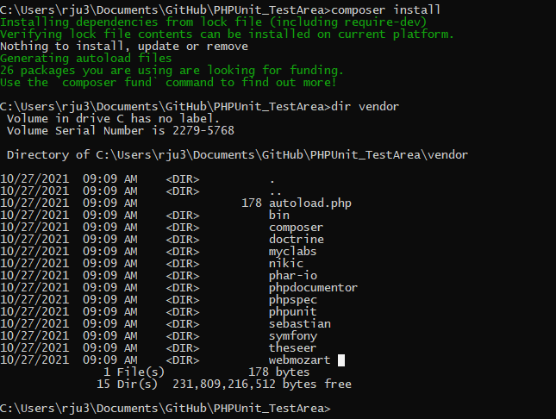
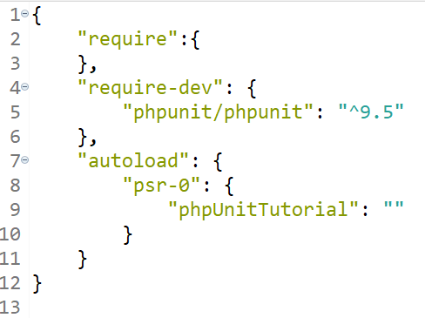
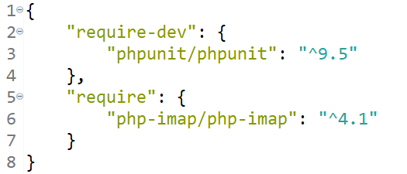
How the tool works - Composer
Example 1
Example 2
Notes:
Composer looks for the composer.json file.
Inside the composer file, the required dependencies are listed under “require”. Two examples provided in this slide.
The first example is for the tutorial I will be using throughout this presentation. The second is the composer file we used for our email client. You can see that in our second example we need to be abler to install some IMAP functionalities for our project.
In each, we can clearly see both require PHPUnit 9.5 to be installed.
To install PHPUnit, the user types in “composer install”, which can be seen at the top of the image in this slide. Composer then goes through the process of installing PHPUnit and any other dependencies inside a folder named “vendor”. After installation, if we look inside this folder, we can see that PHPUnit has been installed and other default dependencies.

Slide 13
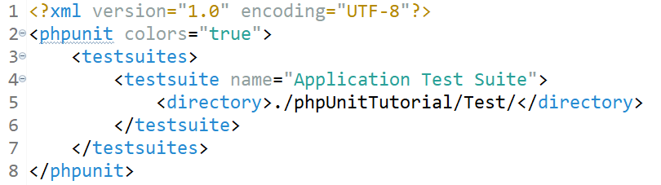
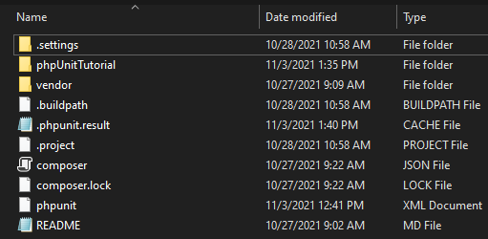
How the tool works – xml file
Tells PHPUnit where the test files are located
Can be used to modify PHPUnit default settings
File is located in same location as /vendor
Notes:
To use PHPUnit, the user needs to tell PHPUnit how to execute the tests. T
PHPUnit uses an xml file titled phpunit.xml. The xml file tells PHPUnit where the test files are located and if there are any other specific settings that should be changed. An example is provided above. This example tells PHPUnit to display colors for pass/fail conditions of our test cases and where these test cases can be located.

Slide 14
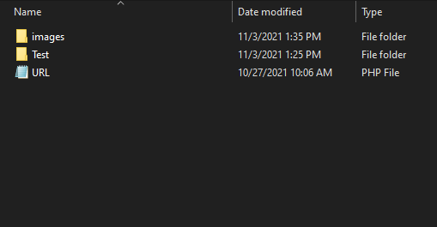
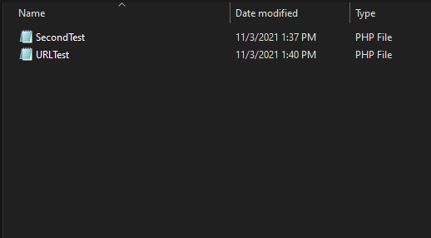
How the tool works – xml file
Notes:
You can see the files we are using for testing in this slide. In the left image, the URL.php file is the file we are testing. The right image are the two files that contain the unit tests.

Slide 15
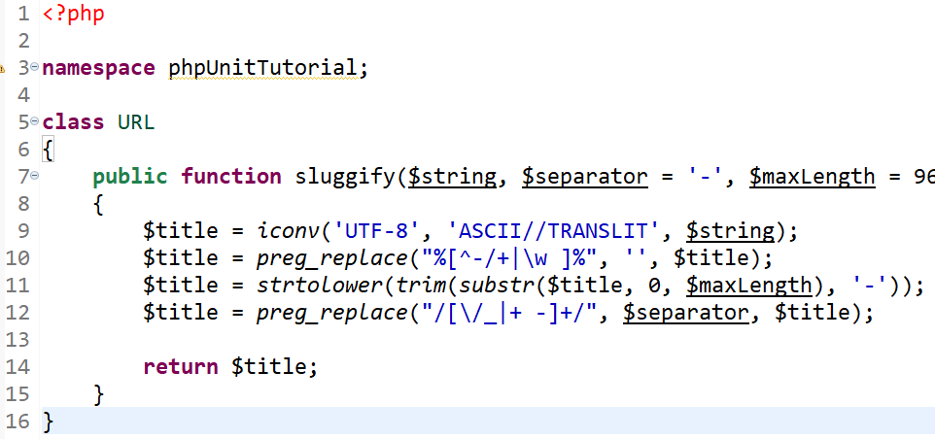
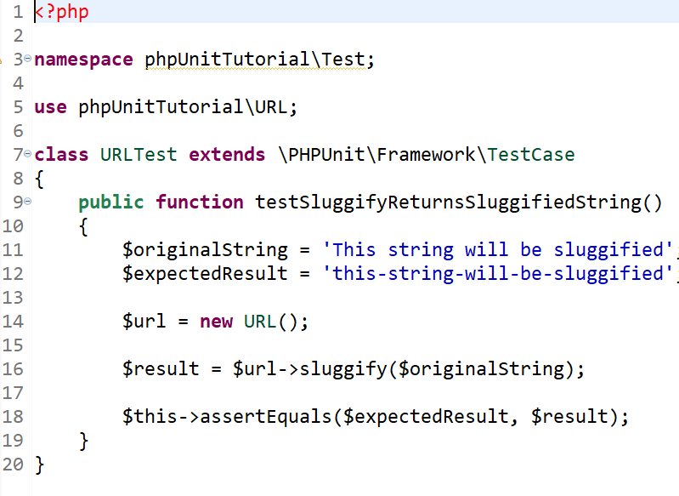
How the tool works – Test Cases
Test Cases should reflect small individual snippets of your code
Smaller the better
Located in a separate directory
Must have the word “Test” appended at the end of file names
Extend PHPUnit TestCase class
Assertions are the “test”
Notes:
Test cases should be very small snippets of code. Typically the smaller the better, but they shouldn’t be so small and simple they don’t provide any real feed back to the functionality of the code being tested.
Test cases should be placed in a separate directory from the developed code, but the overall file structure of the test cases should match the structure of the developed project.
PHPUnit looks for files with the wort “Test” appended to the end of the file names
Classes need to extend the TestCase class within PHPUnit. This class contains assertion methods which are used as the pass/fail conditions of our tests.
In our example, in the snippet at the top, is the code for a function that takes in a string, lower cases all of the capital letters, and adds a dash where there were originally spaces. This method is called sluggify. This method takes in a string and returns a modified string.
We want to test that this method works. The second snippet of code is our test case to do this. This test calls the URL.php file and extends the PHPUnit TestCase method so we can use assertions.
For this test, we are going to give the sluggify method a string and what we expect the proper return to be.
So in this case, we pass the string to sluggify, and look at the return. We use an assertion to compare the result to what’s expected. If the two are the same, the assertion passes.

Slide 16
How the tool works – Test Cases
Test Cases should reflect small individual snippets of your code
Smaller the better
Located in a separate directory
Must have the word “Test” appended at the end of file names
Extend PHPUnit TestCase class
Assertions are the “test”
Notes:
Test cases should be very small snippets of code. Typically the smaller the better, but they shouldn’t be so small and simple they don’t provide any real feed back to the functionality of the code being tested.
Test cases should be placed in a separate directory from the developed code, but the overall file structure of the test cases should match the structure of the developed project.
PHPUnit looks for files with the wort “Test” appended to the end of the file names
Classes need to extend the TestCase class within PHPUnit. This class contains assertion methods which are used as the pass/fail conditions of our tests.
In our example, in the snippet at the top, is the code for a function that takes in a string, lower cases all of the capital letters, and adds a dash where there were originally spaces. This method is called sluggify. This method takes in a string and returns a modified string.
We want to test that this method works. The second snippet of code is our test case to do this. This test calls the URL.php file and extends the PHPUnit TestCase method so we can use assertions.
For this test, we are going to give the sluggify method a string and what we expect the proper return to be.
So in this case, we pass the string to sluggify, and look at the return. We use an assertion to compare the result to what’s expected. If the two are the same, the assertion passes.

Slide 17
How the tool works – Assertions
Variety of assertion methods are available
See full PHPUnit documentation on how to utilize each
Few Examples:
assertTrue()
assertFalse()
assertEquals()
assertEmpty()
assertIsBool()
assertIsString()
Notes:
PHPUnit has over 60 different assertions that can be used. Users are encouraged to thoroughly look through the PHPUnit documentation (provided in the reference slide). A few useful examples are provided in this slide.

Slide 18
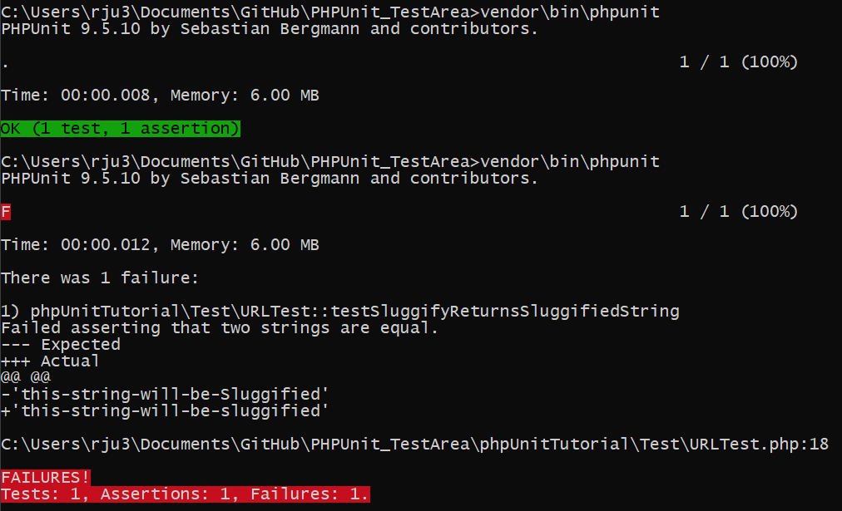
How the tool works – Execution
Run PHPUnit batch file
vendor\bin\phpunit
PHPUnit will print the results to the command line
Notes:
To execute PHPUnit, the user needs to use vendor\bin\phpunit to execute the batch file.
PHPUnit then uses the xml file to execute the test cases.
If test cases pass, they are displayed with the number of tests, number of assertions, and the number of those that pass or fail at the command line. Green will be displayed if all of the test cases pass. Red will be displayed if a test case fails.
For our example, I run the test cases and demonstrate that the sluggify function works properly.
To demonstrate a failure, I intentionally break the function. We can see a pass and fail case in the graphic above.

Slide 19
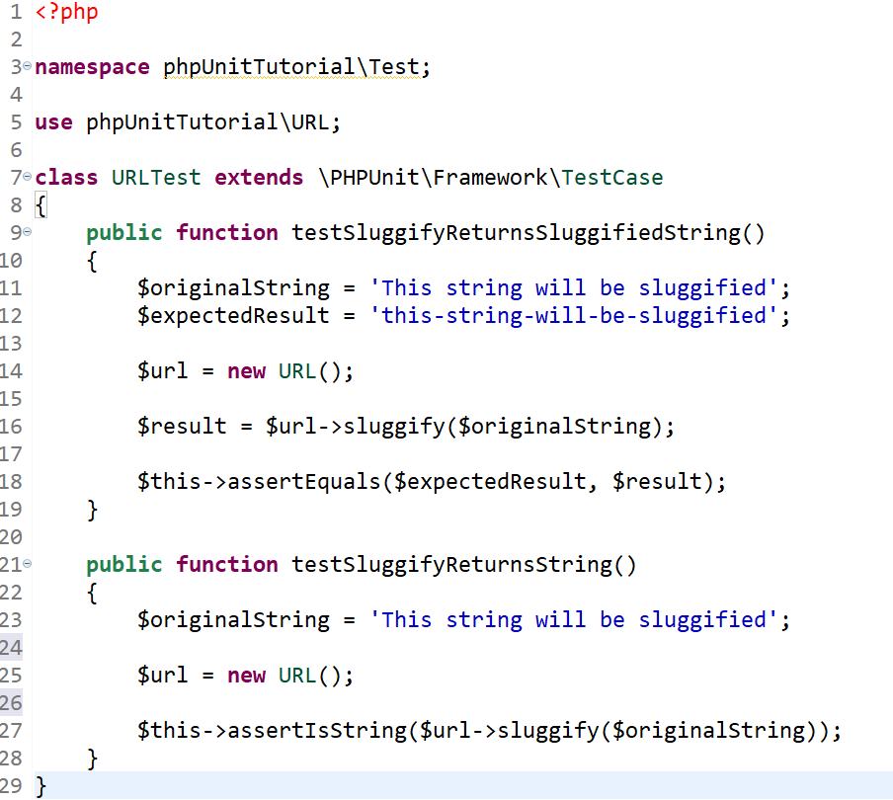
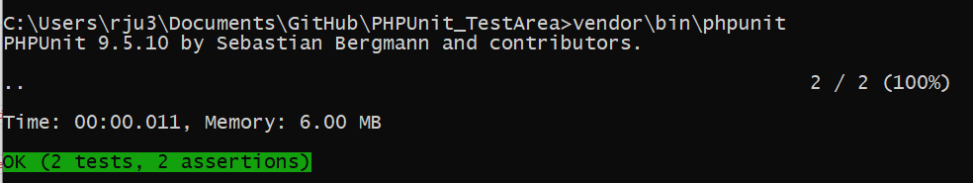
How the tool works – Execution
Notes:
Test case files can have more than one method for testing as well.
In this slide, we add another method that tests if a string is returned. The assertion looks and identify is a string is returned.
When executed, the user can now see that two tests and assertions were executed.

Slide 20
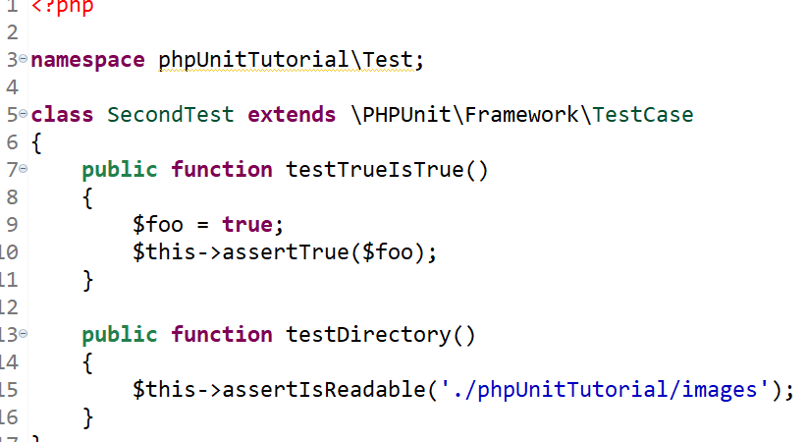
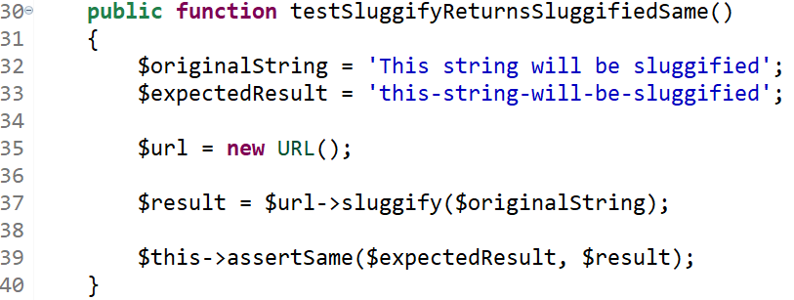
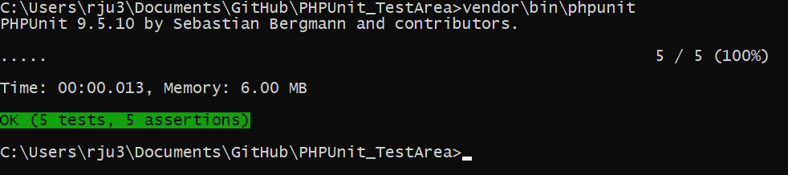
How the tools Works – More Simple Examples
Notes:
To further show how more test cases in addition to the already demonstrated test cases.
In the left snippet, we use the assertSame method, which functions similarly to the assertEqual.
In the right, we use the assertTrue method, even though in this case it doesn’t really do much.
The assertIsReadable can be used to check if the proper file structure is present.

Slide 21
Conclusion
PHPUnit is a simple framework for testing PHP functionality
A large number of assertions are available
Supported on Linux/Unix/Windows
Available on Travis
Requires knowledge of use of PHP
Back end dependencies
And file configurations
Notes:
For our testing tool, we decided to use PHPUnit because this was the testing methodology we used for our email client.
PHPUNit is a simple framework for testing PHPUnit functionality. It works purely from the command line and is available for almost every major environments.
The PHPUnit framework has a large number of assertions which can be used to a wide range of developments.
PHPUnit is also built into a some continuous integration services, such as Travis.
However, PHPUnit does require the user be knowledgeable of PHP. In cases where functions do not return something specific, testing can be a little more difficult.
PHPUnit can be a little confusing and difficult to setup and execute if the user is not comfortable setting up configuration files and back end dependencies.
Overall, PHPUnit is a free and relatively easy framework to use for PHP development once properly configured.
This concludes our presentation, thank you for your time.

Slide 22
References
https://andy-carter.com/blog/phpunit-what-why-how
https://en.wikipedia.org/wiki/PHPUnit
https://www.sitepoint.com/tutorial-introduction-to-unit-testing-in-php-with-phpunit/
https://phpunit.readthedocs.io/en/9.5/
https://jtreminio.com/blog/unit-testing-tutorial-part-i-introduction-to-phpunit/
https://www.cloudways.com/blog/getting-started-with-unit-testing-php/
https://getcomposer.org/

